Slide 1
Malignant Comment Classifier
By Vishal Lakhera

Slide 2
Problem associate with malignant comments
A malignant comment is defined as a rude, dis- respectful, or unreasonable comment that is likely to make other users leave a discussion. The proliferation of social media enables people to express their opinions widely online. However, at the same time, this has resulted in the emergence of conflict and hate, making online environments uninviting for users. Although researchers have found that hate is a problem across multiple platforms, there is a lack of models for online hate detection.
Online hate, described as abusive language, aggression, cyber bullying, hatefulness and many others has been identified as a major threat on online social media platforms. Social media platforms are the most prominent grounds for such toxic behaviour.
There has been a remarkable increase in the cases of cyber bullying and trolls on various social media platforms. Many celebrities and influences are facing backlashes from people and have to come across hateful and offensive comments. This can take a toll on anyone and affect them mentally leading to depression, mental illness, self-hatred and suicidal thoughts.

Slide 3
The data set contains the training set, which has approximately 1,59,000 samples and the test set which contains nearly 1,53,000 samples. All the data samples contain 8 fields which includes ‘Id’, ‘Comments’, ‘Malignant’, ‘Highly malignant’, ‘Rude’, ‘Threat’, ‘Abuse’ and ‘Loathe’.
The label can be either 0 or 1, where 0 denotes a NO while 1 denotes a YES. There are various comments which have multiple labels. The first attribute is a unique ID associated with each comment.
The data set includes:
Malignant: It is the Label column, which includes values 0 and 1, denoting if the comment is malignant or not.
Highly Malignant: It denotes comments that are highly malignant and hurtful.
Rude: It denotes comments that are very rude and offensive.
Threat: It contains indication of the comments that are giving any threat to someone.
Abuse: It is for comments that are abusive in nature.
Loathe: It describes the comments which are hateful and loathing in nature.
ID: It includes unique Ids associated with each comment text given.
Comment text: This column contains the comments extracted from various social media platforms.

Slide 4
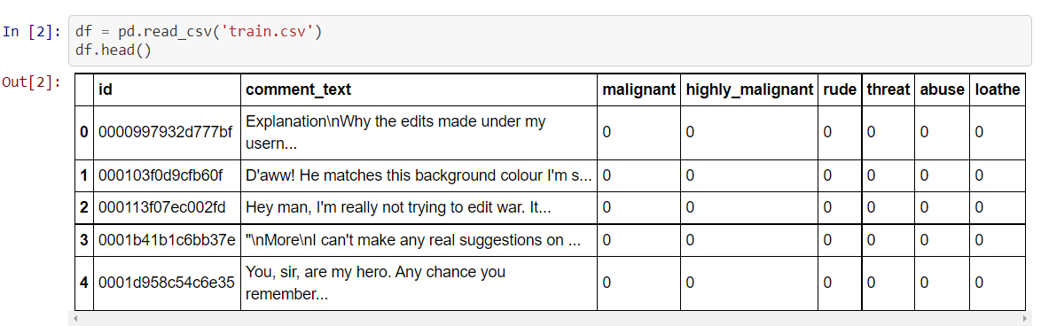
Loading the Data:
By looking at the shape of our training data set we came to know that this data set is having 159571 rows and 8 columns. Where malignant, highly_malignant, rude,threat, abuse and loathe are our target variabls which are with binary values.

Slide 5
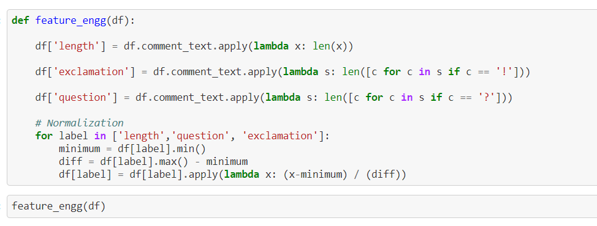
Feature Engineering
I am creating a function for feature engineering and making three different columns using comment_text column
Length: indicating the length of the text.
Exclamation: indicates whether ‘!’ is present in the text or not.
Question: indicates whether ‘?’ is present in the text or not.

Slide 6
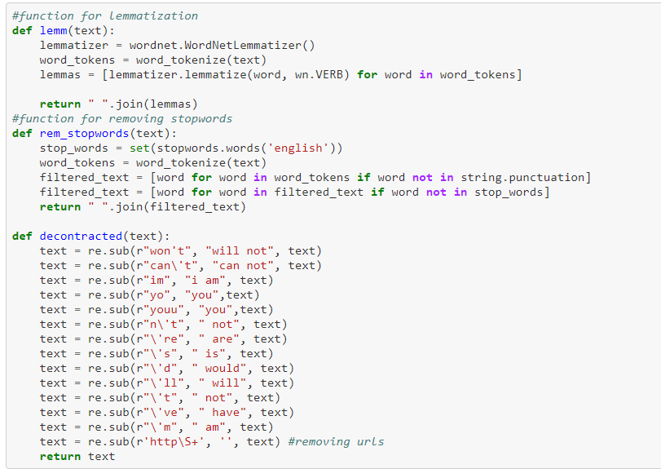
Defining functions for lemmatization, removing stopwords and replacing some words

Slide 7
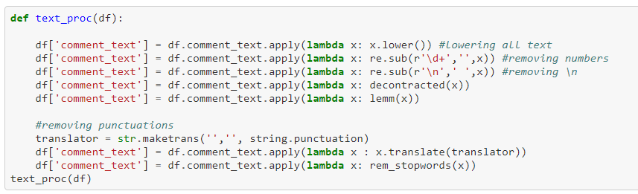
Text Procesing
I have done text processing by using some of the functions which I have defined earlier.
After lowercasing the text I have removed numbers, punctuations and stopwords.

Slide 8
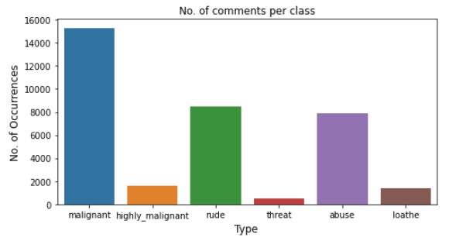
EDA/Data Analysis
The above figure represents count plot for all our labels. Looking at this plot we can conclude that more number of comments has been labelled as malignant compared to others. Very less number of comments has been labelled as threat.

Slide 9
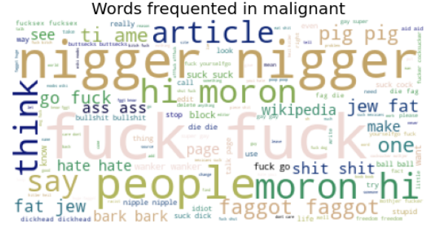
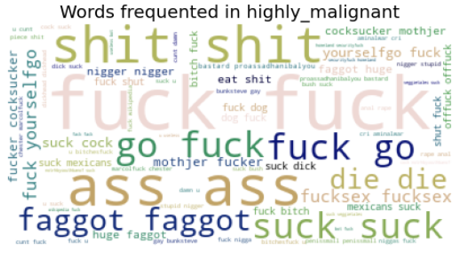
Below figures shows words frequently occurred in the case of malignant and highly_malignant comments

Slide 10
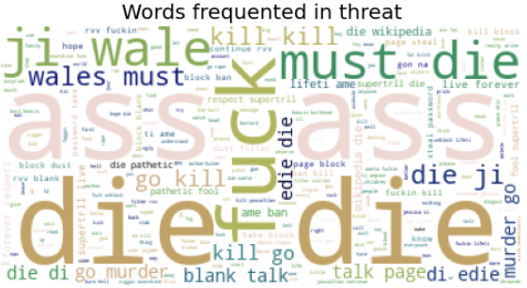
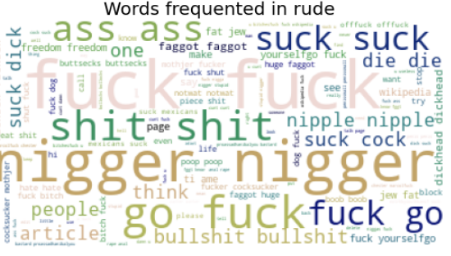
The below figures shows words frequently occurred in the case of threat and rude comments

Slide 11
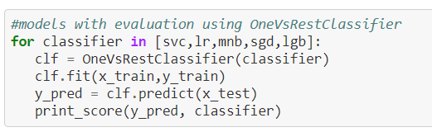
Model building
In this nlp based project we need to predict multiple targets which are binary. I have converted the text into vectors using Tfidf vectorizer and separated our feature and labels then build the model using OneVsRestClassifier. Among all the algorithms which I have used for this purpose I have chosen LinearSVC as best suitable algorithm for our final model as it is performing well compared to other algorithms while evaluating with different metrics.
I have used following algorithms and evaluated them
LinearSVC
LogisticRegression
MultinomialNB
LightGBMClassifier
SGDClassifier

Slide 12
Key Metrics for success in solving problem under consideration
I have used the following metrics for evaluation:
As this is classification problem I am using accuracy score here. But this is a case of multi-target classification so we can’t consider accuracy_score as a major factor.
I have used jaccard score. Jaccard similarity coefficient score. The Jaccard index [1], or Jaccard similarity coefficient, defined as the size of the intersection divided by the size of the union of two label sets, is used to compare set of predicted labels for a sample to the corresponding set of labels in y_true .
I have also used f1_score, precision_score, recall_score, multilabel_confusion_matrix and hamming loss all these evaluation metrics to select best suitable algorithm for our final model.

Slide 13
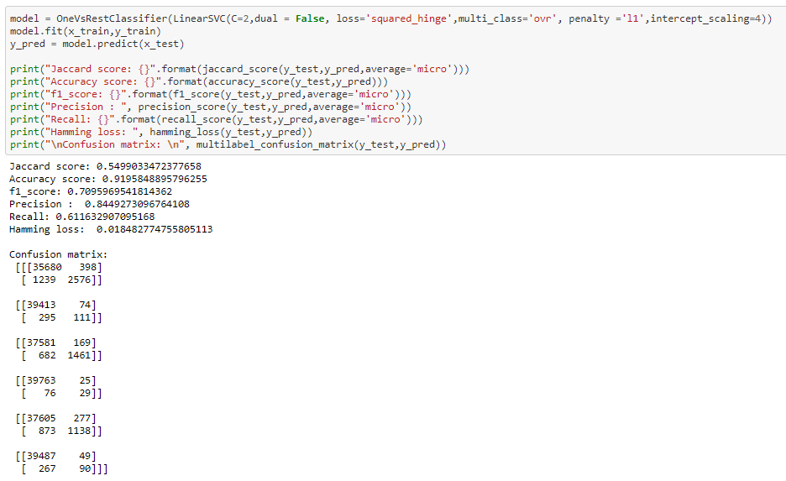
Final model
I did hyper-parameter tuning for selected model through which I got the best parametric values for my final model and then tested our final model with these parameters.

Slide 14
Conclusion
At the end I have saved this final model and using this model made predictions for our test data set by doing all the required processing for the test data.
For this project we have provided with huge amount of comments with multiple targets which are binary in nature. I observe that there are many words with incorrect spellings. At first I have created three columns one is with the length of the text, another as ‘question’ whether the comment contains ‘?’ mark or not and third as ‘exclamation’ whether the comment contains ‘!’ mark.
To clean the column comment_text I have gone through different text processing steps like lowercasing the text, removing unwanted elements like stopwords, ‘\n’, Urls, numbers, punctuations etc.
As the text column is with many miss-spelled words and the problem is multi-labelled so we are getting slightly lower accuracy for this task. However we have selected best model among all the algorithms. There are some comments which are from different language other than English we can try the same approach by removing those comments with other languages.

